Slide 1
As you come in…
Have either a blank word document or one of the resume tools from the ENGR 111 files open
M4 – Careers in ENGR 111 Canvas
Share where you are zooming from in the chat!

Slide 2
Resume Clinic - Engineering LC 2020
Kelly Tierney
Assistant Director, Experiential Learning
Career Design & Development
Kmtierney@widener.edu

Slide 3
How this works
1. Have a blank word document or one of the resume tools provided to you in ENGR 111 open
2. One at a time, I will review each section. I will then provide time for you to work on that section (just that section!).
***This is a great time to ask questions via the chat or using the raising hand function.
3. When I move on to the next section, I ask that you move on to the next section with me. You can come back to unfinished parts later.

Slide 4
General Resume Rules
Your Marketing Document - Remember the suitcase
Chronicles experience, education, accomplishments
Easily scanned; bulleted and concise
Written in first person (no I, me, my)
Remove articles (the, a)
1-page maximum for students
Do not use a template
Consistent Formatting: Margins (.5-1 inch), Font, selectively and consistently use bold/italics

Slide 5
Sections we will review today
Banner/Contact Information*
Education*
Research Experience
Professional Experience
Volunteer Experience/Additional Experience
Leadership Positions and Activities
Professional Organization Memberships
Skills (Laboratory, Computer, Language)

Slide 6

Banner Sample
Name (use a larger font)
Phone Number (1), Address (1), Email (1)
Customized LinkedIn link
Can play with font and style
To create line: === ENTER

Slide 7

Banner Sample

Slide 8
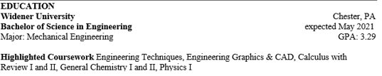
Education Sample
List school, city, state, degree, major(s), minor(s), GPA, expected date of graduation
High School: should be removed by sophomore year
Academic honors, scholarships
Related coursework, labs, projects
Study abroad

Slide 9
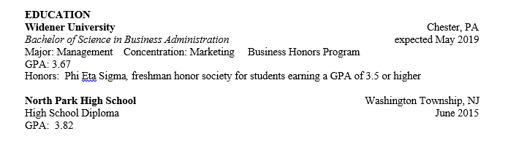
Education Sample

Slide 10
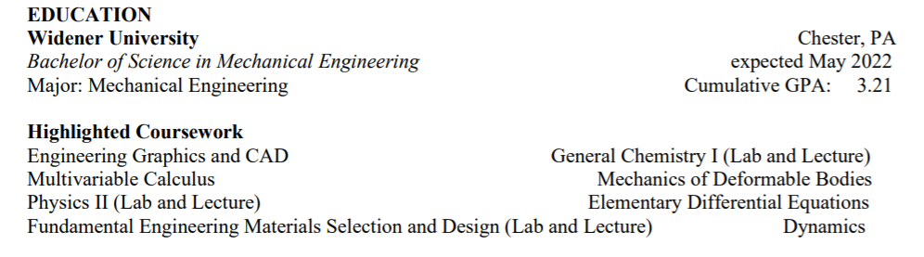
Education Sample

Slide 11
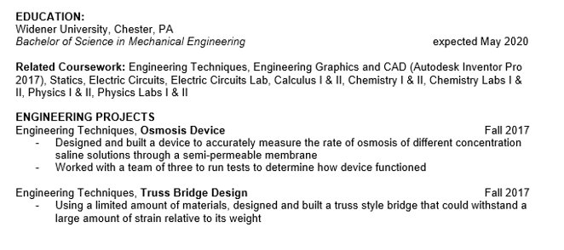
Education Sample

Slide 12
EXPERIENCE

Slide 13
Breaking it Down: Experience
Lead with what is most directly related to your chosen field, paid or unpaid
Part-time jobs, service learning, internships, volunteer experience – can have multiple "experience" sections with different titles
Highlight transferable skills (e.g., lifeguard = calm and steady/crisis management skills)
Reverse chronological order and consistent formatting
2-6 bullet points as a guideline for each experience

Slide 14
Resume Bullet Composition
ACTION VERB + TASK + IMPACT (results)
IMPACT
How did I do this?
Why did I do this?
What were the results of my work?
What changed because I did this?
Tip: Your resume should not read exactly like the job description. What did you bring to this experience?

Slide 15
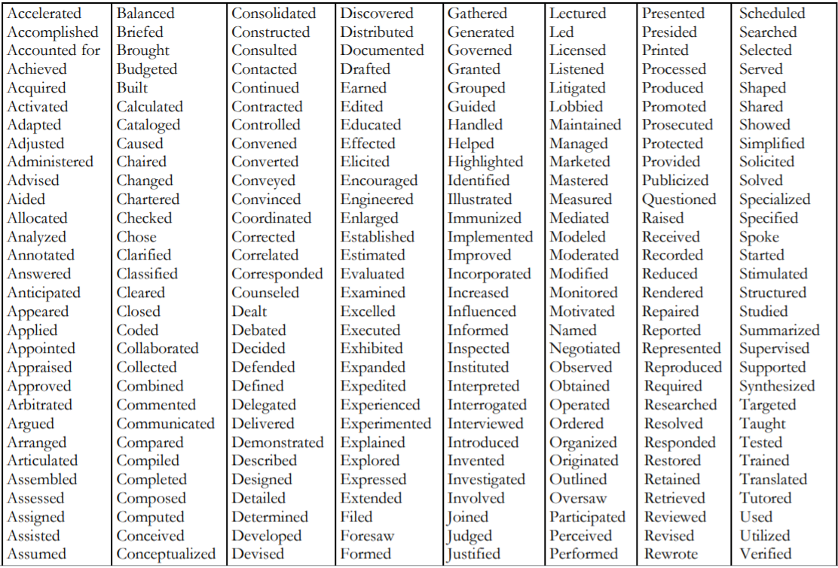
Action Verbs List

Slide 16

Before you begin writing the rest of your sections, take a minute to jot down some skills you have that you want employers to know about!
Example:
- safety (lifeguard experience)
- coding (HS robotics team)
- teamwork (cross country team)

Slide 17
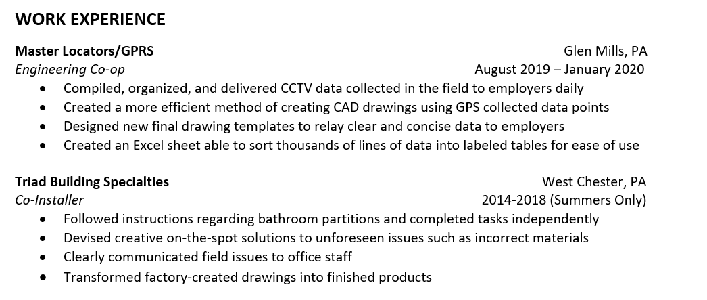
Professional Experience Sample
Bullet points starting with descriptive verbs
Quantified when possible
Used key words and highlighted transferable skills
Example of a summer-only job

Slide 18
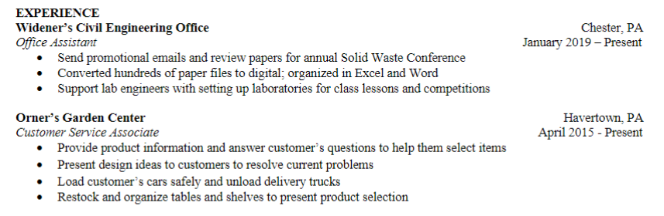
Professional Experience Sample
Descriptive verbs in the correct tense
Consistent formatting
Spoke to why/outcomes of work
Highlighted transferable skills
Quantified when possible

Slide 19
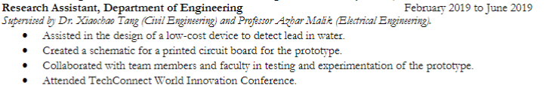
Breaking it Down: Research
Treat as a job: List site, location, role, dates, supervisor
Site may be Widener University department or external lab
For bulleted descriptions, include:
Title and overall scope of project or study
Your specific role on research team
Any key or early learning/results
Any associated presentations or publications

Slide 20
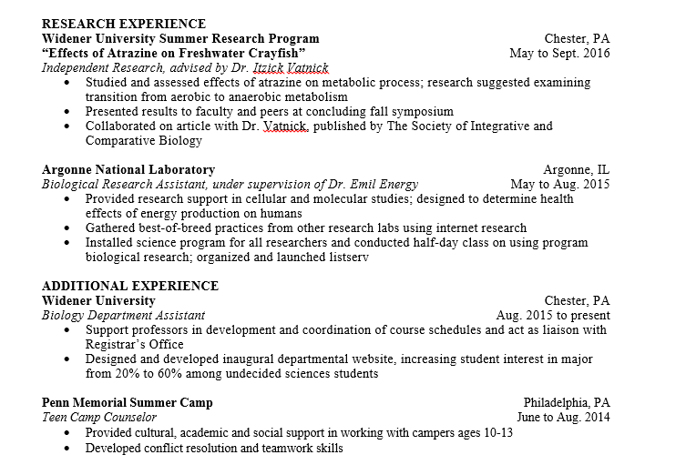
Research Experience Sample

Slide 21
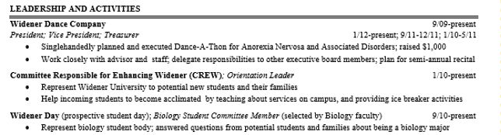
Breaking it Down: Leadership and Activities
Include leadership positions and dates of involvement
Think beyond student organizations: Oskin certificate, leadership roles in lab or on major course projects, e.g.

Slide 22
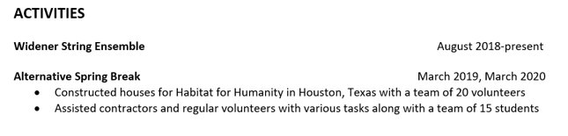
Leadership and Activities Sample

Slide 23
Leadership and Activities Sample

Slide 24
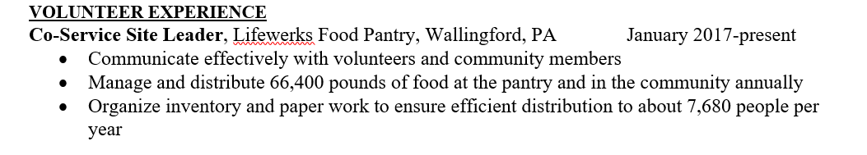
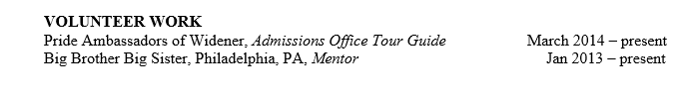
Volunteer Experience Samples
Format like a job, using same principles
Bullet points optional, depending on space and how relevant
Highlight transferable skills

Slide 25

Breaking it Down: Skills and Certifications
Section for objective “hard” skills: Laboratory, Language, Computer, Certifications
Your “soft” skills such as communication should come through in your descriptive bullets in other sections
Include level of proficiency (if you say you’re fluent in Spanish, don’t be surprised if asked a question in Spanish!)

Slide 26
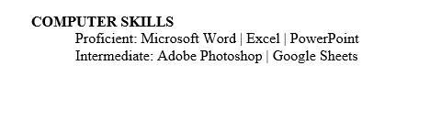
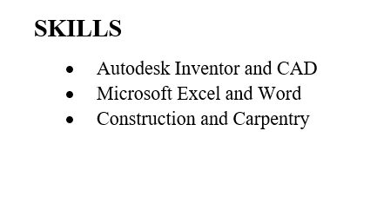

Skills Sample

Slide 27
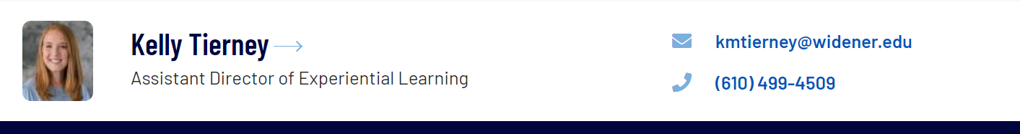
Remember to schedule your resume review for ENGR 111 if you haven’t yet
https://www.signupgenius.com/go/20f044caea82ea4fa7-engr

Slide 28
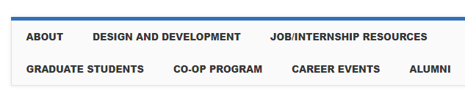
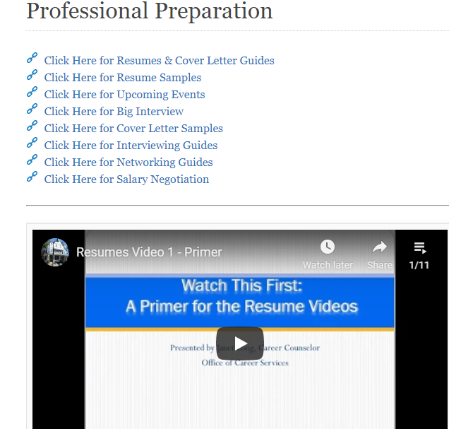
MyWidener Resources 24/7: Start Here
Career Design and Development

Slide 29
Career Design and Development is here to help!
Resume and cover letter assistance
Career exploration
Job search strategies
Interviewing assistance
Walk-in hours via Zoom: Mon-Thurs, 1 to 3 pm
  https://widener.zoom.us/j/2222998909
Email careers@widener.edu or your career counselor to schedule an appointment

