Slide 1
undergraduate Catalog and
Registration guide
Questions? Contact Associate Director of Advising, Rhonda Bates, MSW at rmbates@widener.edu

Slide 2
Preparing for
Registration
Before beginning the registration process, students should check for possible holds to be settled.
Students should check the Undergraduate Catalog to review the curriculum sequence for their respective majors/minors.
Students should plan their schedule in students planning with guidance from the respective curriculum sequence.
Student should meet all other pre-registration expectations.
Student should schedule a meeting with their academic advisor to finalize schedule and approval for registration.

Slide 3
Getting Started
3/10
Go to Widener.edu
Click on “Academics”

Slide 4
Accessing Undergraduate Catalogs
4/10
Click on “Catalogs”

Slide 5
Accessing Undergraduate Catalog
5/10

Slide 6
6/10

Slide 7
After selecting your major, you will be redirected to the major’s overview page.
7/10
Below is an example of a major’s overview page

Slide 8
Example of
Curriculum Sequence
The hyperlinks provide course descriptions and indicates if there are pre- or co-requisites for the course.
Sequence is divided by academic standing
Suggested number of credits to register for

Slide 9
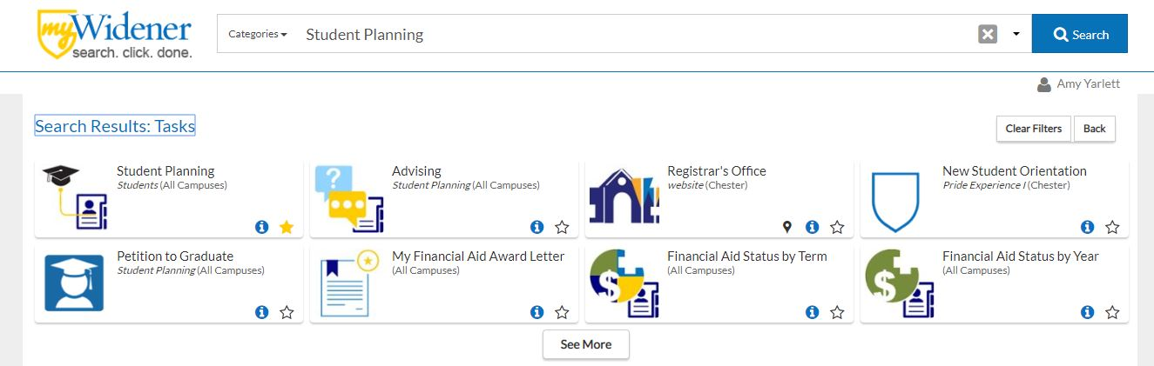
After reviewing the course catalog, students should plan for the appropriate courses in Student Planning.
9/10
Log into www.widener.edu myWidener
Type Student Planning into search bar
Click on the Student Planning banner
1
2

Slide 10
Planning Classes
10/10
Click on “Plan your Degree & Register for Classes”

Slide 11
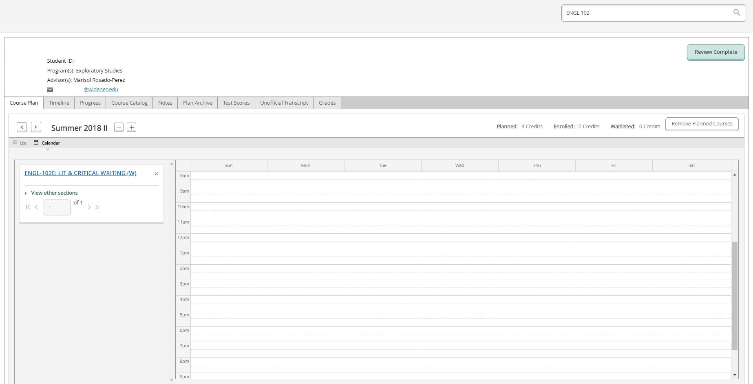
Searching for Classes
11/10
Type the course name and number in the search box
  Example: ENGL 101

Slide 12
Advance search for courses
Click here!

Slide 13
Advance search for courses
From the menu bar on the left-fand side, click on the graduation cap
Click on ”Course Catalog”
1.
2.

Slide 14
Advance search for courses
Click on “Advance Search”
Select the term
Enter courses if you know the specific course subject and course number! You do not have to enter the course section.
1.
2.

Slide 15
Advance search for courses
Scroll down to select the location, academic level, and course type.
Select the drop down for the course type. The course type advance search option is great for searching for Humanities and Social Science electives!

Slide 16
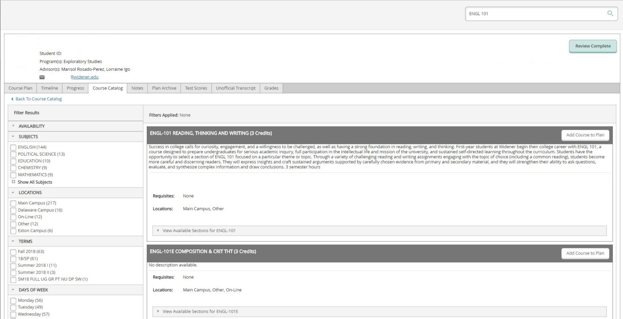
Use filters
16/10
Use filters for “Availability” and “Term” to make your search easier

Slide 17
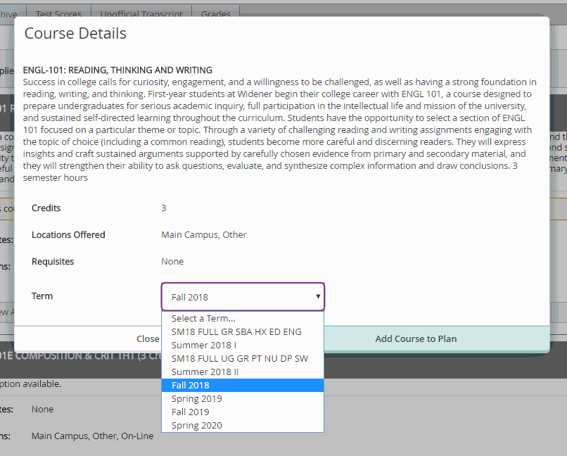
Add Course to Plan
17/10
Select white “Add Course to Plan”
Select Term
Click Green “Add Course to Plan”

Slide 18
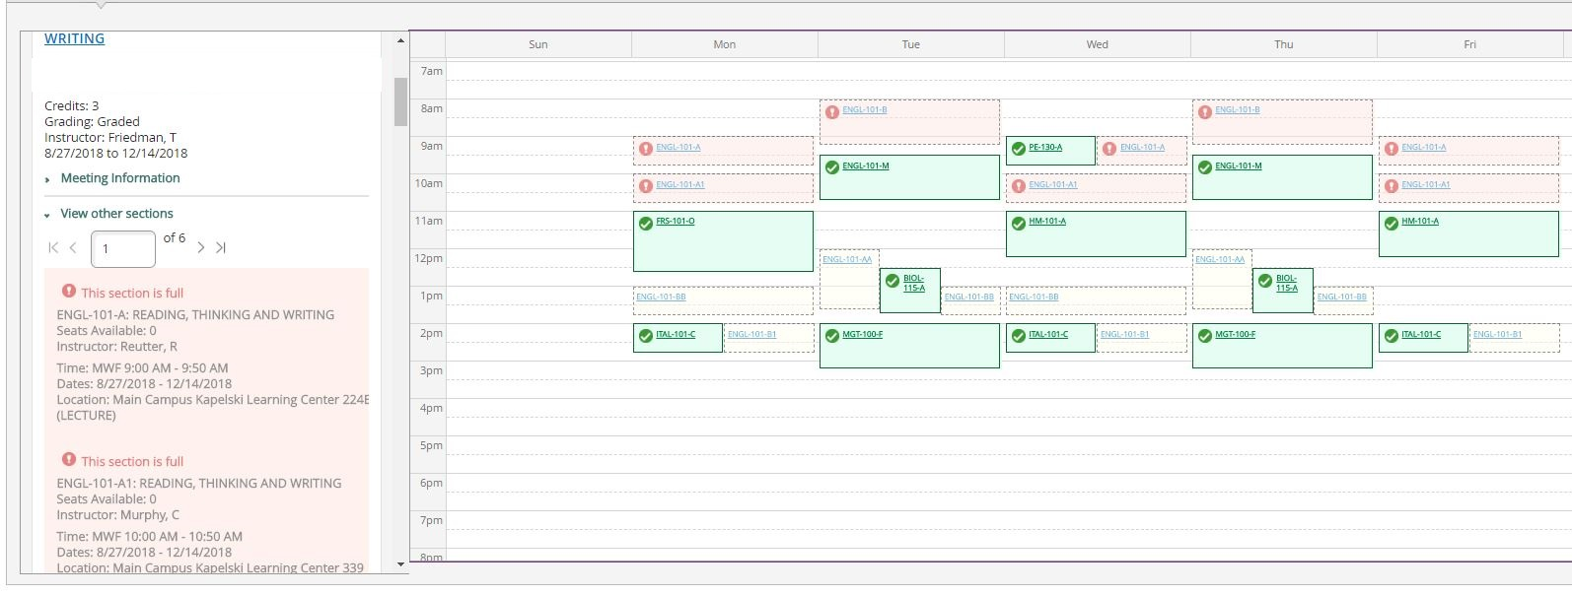
Select sections
When done adding all courses to plan, select sections using “View other Sections”
Select the section that fits best in your schedule
*Note there are more pages to search for sections

Slide 19
Select the right section
19/10
To add that class, click on the section that:
  Does not conflict with other classes (red outline)
  Is available (choose yellow, avoid red!)

Slide 20
Register!
20/10
When all done, click the green register button

Slide 21
Common Registration Errors
Student is trying to register before their registration date and time.
Student does not meet the pre- or co-requisite requirement for a course.
A course is restricted for a specific program/cohort/major.
A planned course conflicts with another course.
A planned section of a course is full.

Slide 22
Questions? Concerns? Need more support?
Contact
Rhonda Bates, MSW
Associate Director of Advising
610-499-1267
rmbates@widener.edu

