Slide 1
SGA Finance Training
THURSDAY, OCTOBER 28, 2021
HOSTED BY STUDENT GOVERNMENT ASSOCIATION

Slide 2
WELCOME!
Mason Klaus, VP of Finance

Slide 3
PRESENCE CHECK-IN
YZML

Slide 4
Budget Allocation Request

Slide 5
Budget Allocation Rules and Guidelines
The Finance Committee of the Student Government Association will review all budget allocation proposals.
Currently composed of
VP of Finance, Mason Klaus
Senators, Leo-Paul Wahl and Carter Taylor
The Student Government Association will fund programs, lectures, special guests or speakers, supplies, and other operational expenditures that are available to all Widener Students.
All requests for budget allocation funding requests are required to be documented on the Budget Allocation Request.
Budget Allocation Requests must include a detailed description of each event or activity, a financial breakdown of all expenses and costs, and the number of students who will benefit.
Student organization leaders should be prepared to respond to a request from the SGA Finance Committee to appear and speak on behalf of the organization to clarify any questions that arise from the review and approval process.

Slide 6
Student Activities Fee (SAF) Funding Limitations
SAF funds cannot be used toward events that are discriminatory or limit participation by Widener University students.
Individual apparel will not be funded through the Budget Allocation Process.
SAF funds cannot be used to purchase food for closed meetings or events.
SAF funds cannot be used to purchase any property or supplies that can be obtained from the University.
SAF funds cannot be used to pay for membership dues.
SAF funds cannot be used to purchase alcohol, illegal drugs, firearms or ammunition.
SAF funds cannot be used for donations for charities, or philanthropic events.
SAF funds cannot be used in the hiring of legal services or providing bail bond funds.
SAF funds cannot fund scholarships.
SAF funds cannot be used to fund political campaigns, or groups that have a partisan agenda.

Slide 7
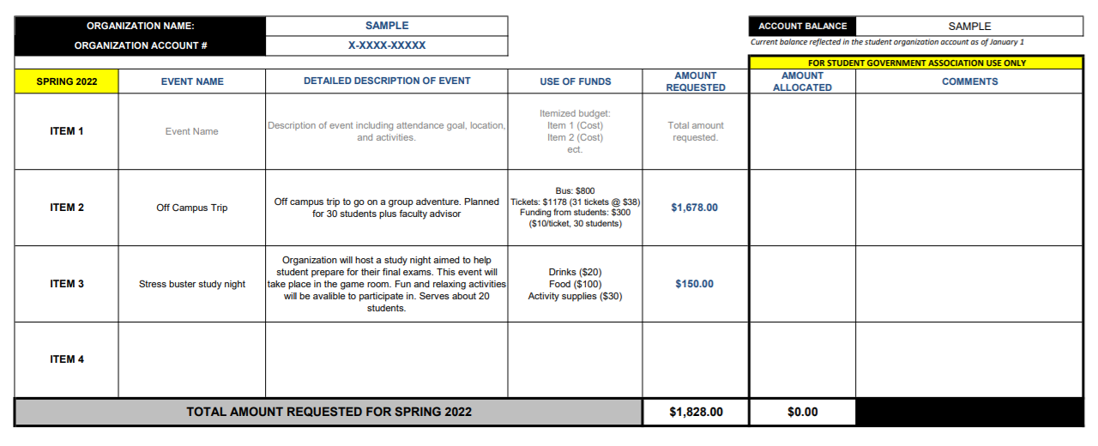

Slide 8
Review of the Finance Manual

Slide 9
For more information: http://sites.widener.edu/rso/policies-and-procedures/

Slide 10
Presence
Only Presidents and Treasures will have access to the Finance section of Presence.

Slide 11
Deposit
Deposits are first made by visiting Business Service Center in Lipka Hall to make the physical deposit and receive a receipt.

Slide 12
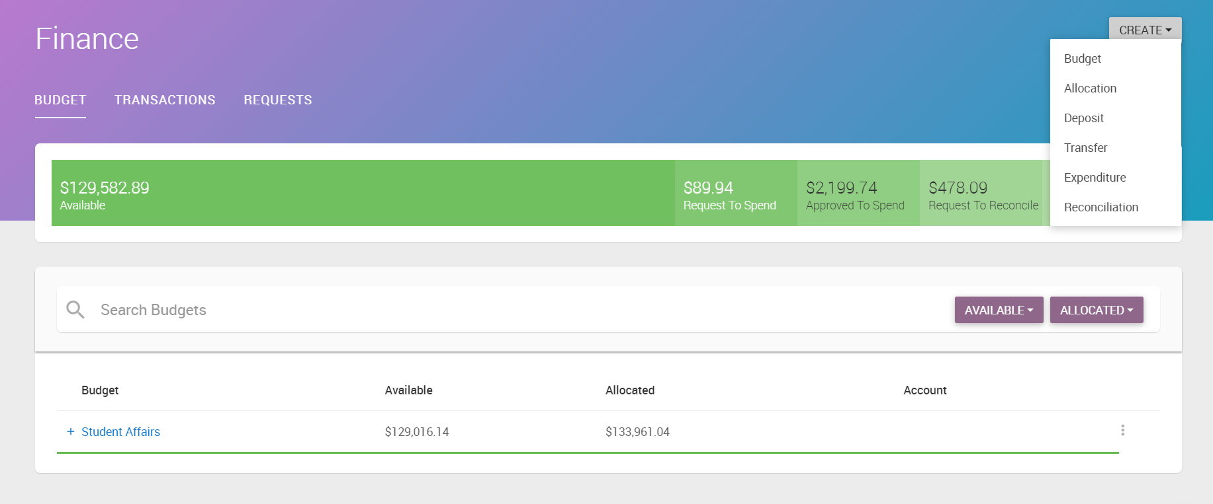

Slide 13
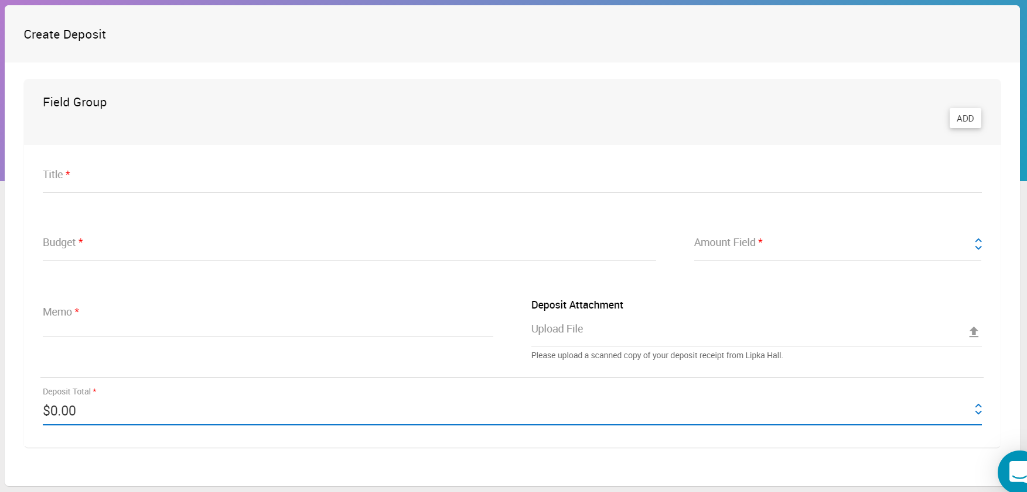
Where did the money come from?
Which budget should the money be put into?
How much was deposited?
A scan of the receipt from Lipka Hall

Slide 14
Expenditure

Slide 15
Complete an expenditure requests a minimum of 2 weeks in advance!

Slide 16
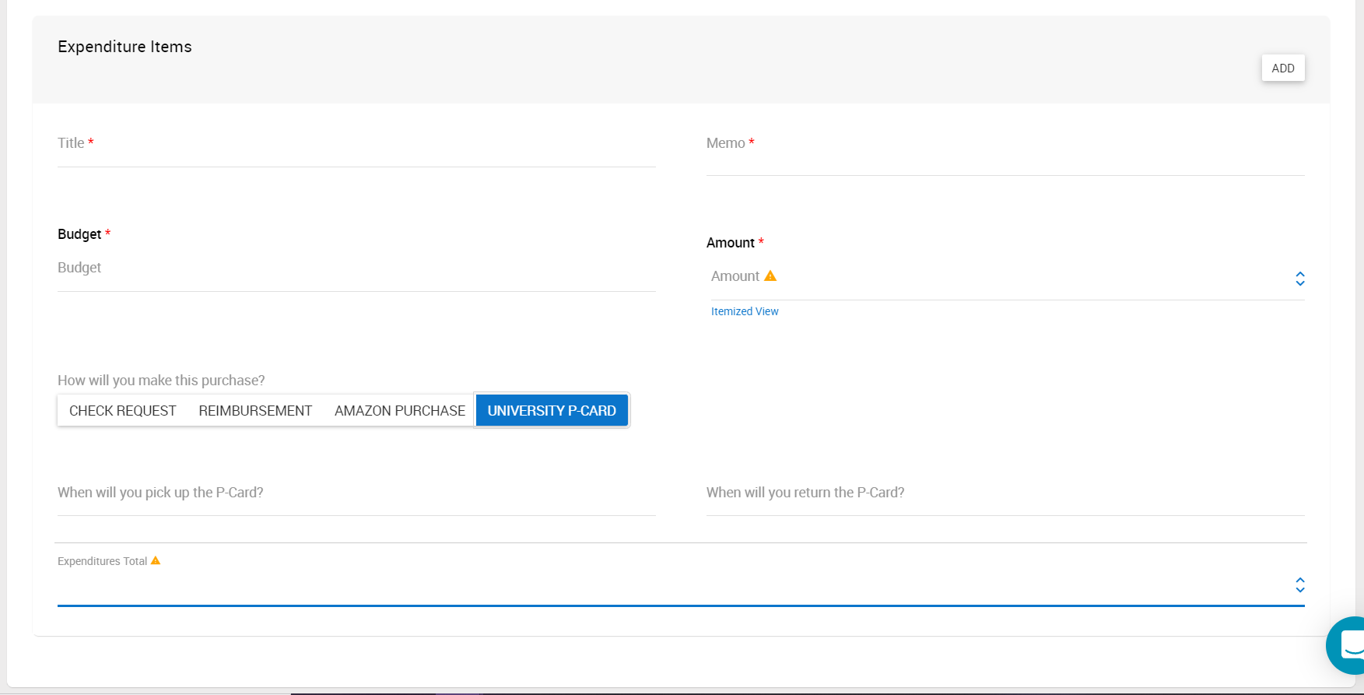
What is the money being used for?
Specific category or items.
Which budget should the money come from?
How much do you expect it to cost?
Only 2 days are allowed between P-card pick up and drop off.

Slide 17
Reconciliation

Slide 19
What is the money being used for?
How much did it cost?

Slide 20
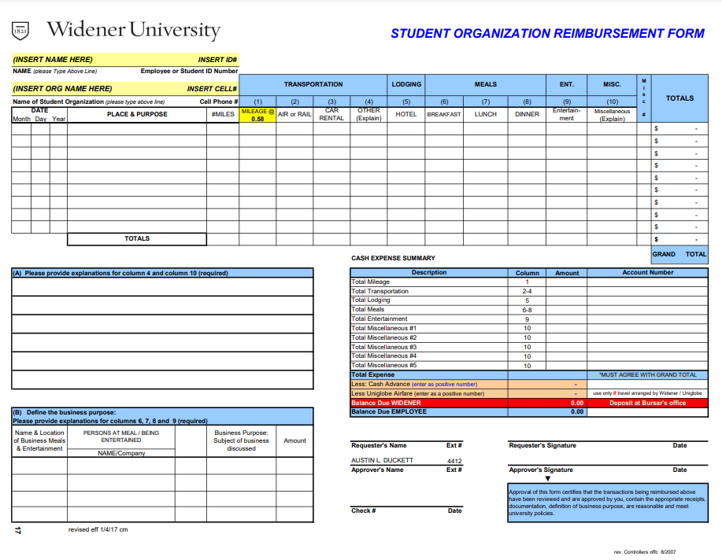
$XX.XX
X-XXXX-XXXXX
$XX.XX
First and Last Name
Signature
MM-DD-YYYY

Slide 21
Fundraisers

Slide 22
Fundraising Limitations
Limited funds for the fundraising efforts of recognized student organizations may be granted with the expectation that any funding issued must be replaced at the conclusion of the fundraising activity.
The organization must provide documentation of the deposit showing a replacement of the funds that were originally granted for the fundraising activity.

Slide 23
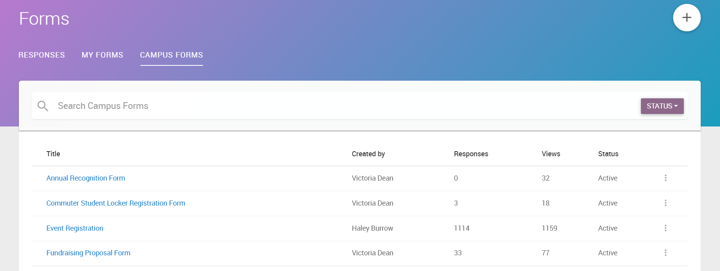
This form is due a minimum of 7 business days in advance.

Slide 24
Questions?

