Slide 1
How to Make PPT Accessible

Slide 2
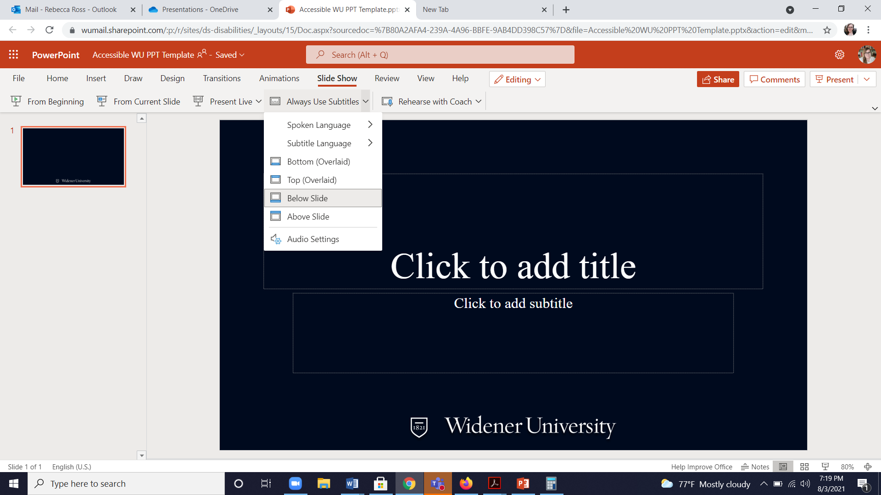
PowerPoint Captioning
You can enable subtitles while presenting form PowerPoint!
Must be on browser version (not the desktop app)
Slideshow>Always use subtitles> check the correct language and layout

Slide 3
PowerPoint Accessibility
Accessibility checker – will do most the work for you
When in doubt, use the templates (also true for Microsoft Word)
Provide slides to students early if possible (so they can use assistive technology to access them if needed)
Explain images or visuals (especially graphs and text based images) out loud

