Slide 1
Enabling Captions in Zoom
Easy as 1, 2…

Slide 2
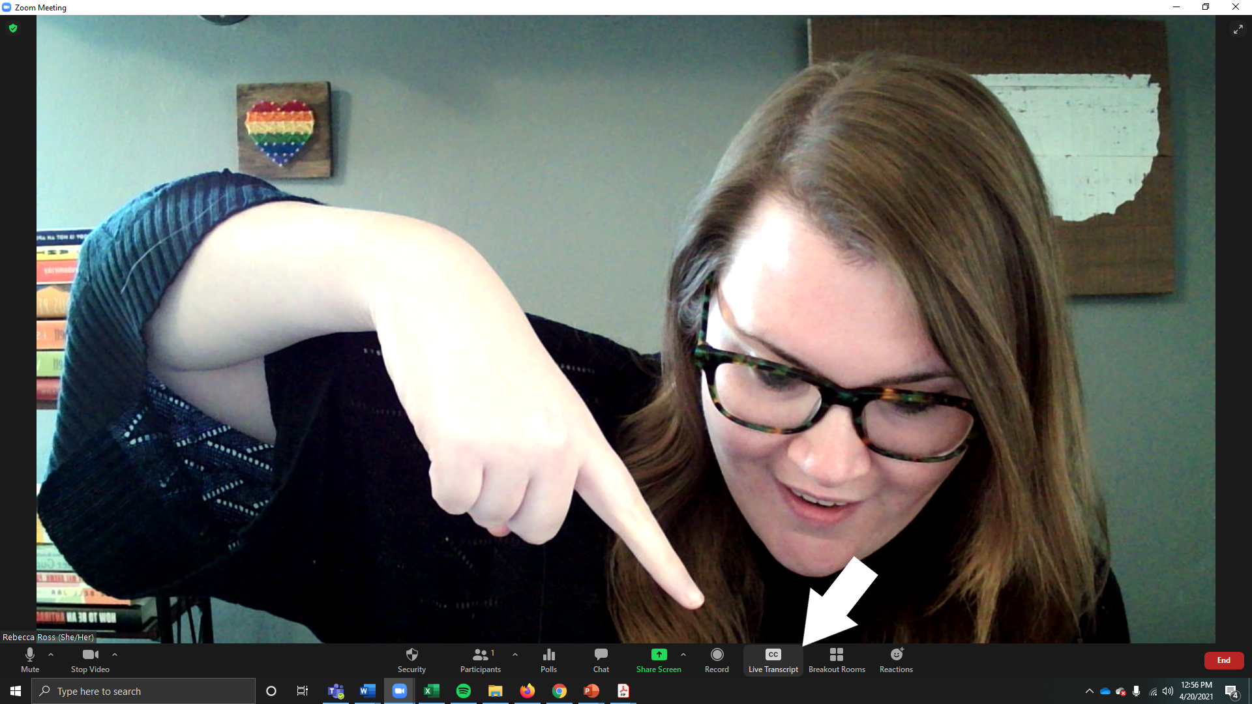
Step 1 to turning on captions on Zoom
Find the Live Transcript button on your zoom toolbar (should be between record and breakout rooms).

Slide 3
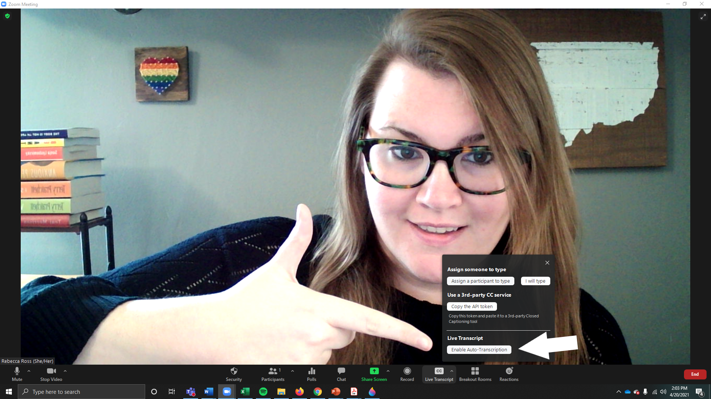
Turning on captions in Zoom: Step 2
Press the “Enable Live Transcription” Button on the bottom of the Live Transcript option screen

Slide 4
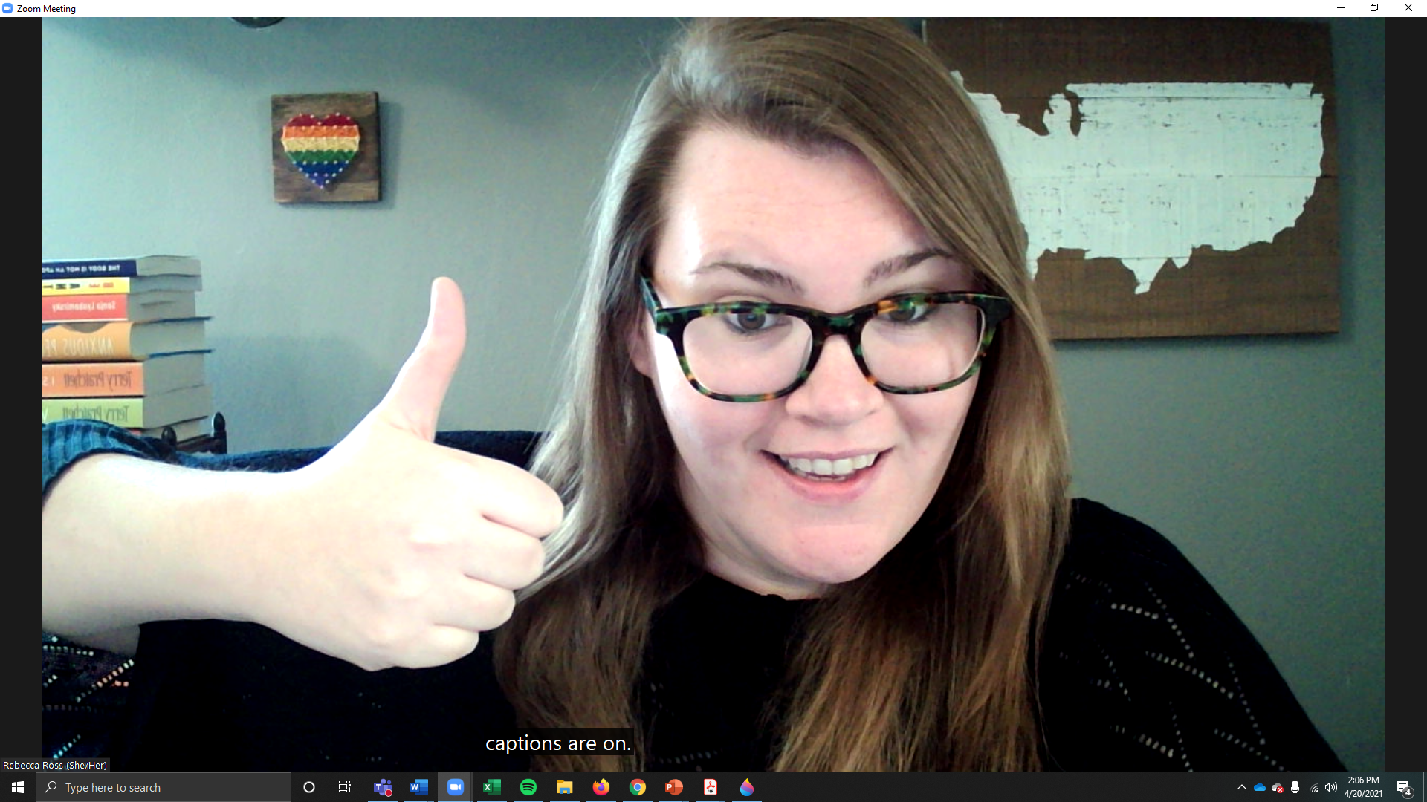
Step 3 to turning on live captioning in Zoom
Just kidding. There’s no step 3. It’s literally 2 steps. You’ve done it!

